Slide 1
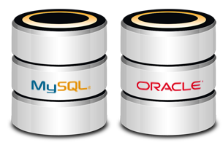
Introduction to Databases Data Definition and Datatypes
How Do RDBMS Work?
SoftUni Team
Technical Trainers
Software University
https://softuni.bg

Slide 2
Table of Contents
Data Management
Database Engine
Structured Query Language
MySQL
Table Relationships
Programmability

Slide 3
Table of Contents
Data Types in MySQL Server
Database Modeling
Basic SQL Queries
Table Customization
Altering Tables
Deleting Data and Structures

Slide 4
Have a Question?
sli.do #java-db

Slide 5

Data Management

Slide 6
Storage vs. Management (1)
SALES RECEIPT
00315 – 07/16/2016
David Rivers
Oil Pump (OP147-0623)
1 x 69.90
Date: 07/16/2016
Order#:[00315]
Customer: David Rivers
Product: Oil Pump
S/N: OP147-0623
Unit Price: 69.90
Qty: 1
Total: 69.90

Slide 7
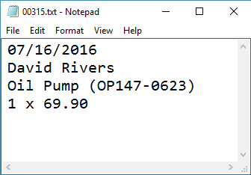
Storage vs. Management (2)
Order# | Date | Customer | Product | S/N | Qty
00315 | 07/16/2016 | David Rivers | Oil Pump | OP147-063 | 1

Slide 8

Storage vs. Management (3)
Storing data is not the primary reason to use a database
Flat storage eventually runs into issues with
Size
Ease of updating
Accuracy
Security
Redundancy
Importance

Slide 9
Databases
A database is an organized collection of related information
It imposes rules on the contained data
Access to data is usually provided by a "system" (DBMS) database management
Relational storage first proposed by Edgar Codd in 1970

Slide 10
RDBMS
Relational Data Base Management System
Database management
It parses requests from the user and takes the appropriate action
The user doesn't have direct access to the stored data
Data is presented by relations – collection of tables related by common fields
MS SQL Server, DB2, Oracle and MySQL

Slide 11


Database Engine

Slide 12





Database Engine Flow
SQL Server uses the Client-Server Model
Clients
Query
Engine
Access
Database
Data
Data

Slide 13

Client-Server Model
CLIENTS
TCP/IP
DATABASE
Notes:
Relational Database Management Systems (RDBMS) are based on a Client-Server model. Normally, clients communicate with the database over (Transmission Control Protocol/Internet Protocol) TCP/IP protocol. TCP/IP is a basic communication language over the internet. It has two layers: - TCP – it is assembling the communication into smaller packages transferred through the internet and received by another TCP which reassembles the packages into the original communication. - IP – responsible for the addresses in order communication to get to the right destination
Here are some of the default ports that databases are using: - MySQL - 3306 - SQL Server - 1433 - Oracle - 1521 Clients – it begins the communication with the server. SQL Server and MySQL have different clients. SQL Server uses SQL Server Management Studio(SSMS). MySQL has many: HeidiSQL, MySQL Workbench etc.

Slide 14
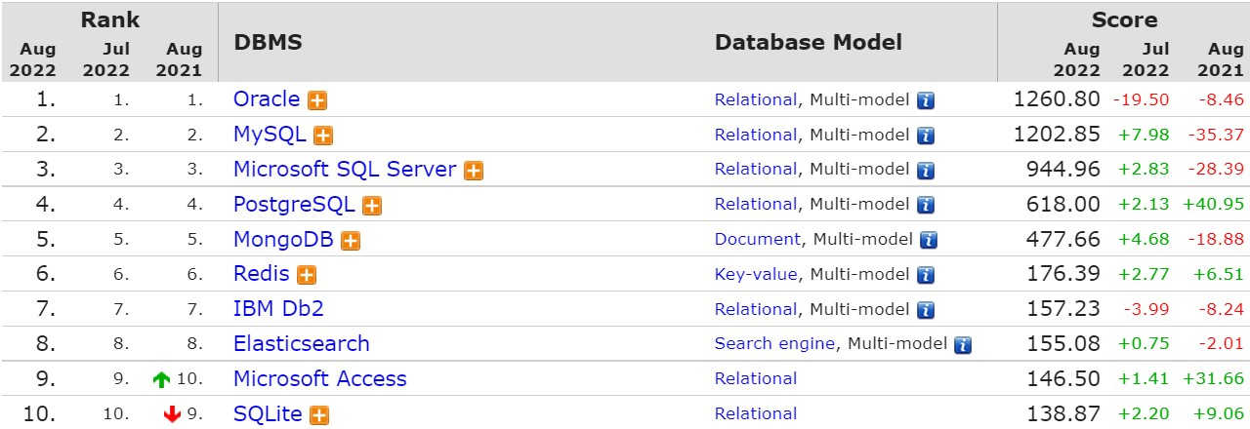
Top Database Engines
Source: http://db-engines.com/en/ranking

Slide 15

Structured Query Language

Slide 16
Structured Query Language (1)
Programming language designed for managing data in a relational database
Developed at IBM in the early 1970s
To communicate with the Engine we use SQL

Slide 17
Structured Query Language (2)
Subdivided into several language elements
Queries
Clauses
Expressions
Predicates
Statements
Update clause
Expression
UPDATE employees
SET salary = salary * 1.1
WHERE job_title = "Cashier";
Statement
Predicate

Slide 18
Structured Query Language (3)
Logically divided in four sections
Data Definition – describe the structure of our data
Data Manipulation – store and retrieve data
Data Control – define who can access the data
Transaction Control – bundle operations and allow rollback

Slide 19
Structured Query Language (4)
SQL
DDL
CREATE ALTER DROP TRUNCATE
DML
SELECT INSERT UPDATE DELETE
DCL
GRANT REVOKE DENY
TCL
BEGIN TRAN COMMIT ROLLBACK SAVE
Notes:
SQL(Structured Query Language) is the main language to access the database. It has many dialects for the different engines. This means that basically MySQL and SQL Server use different syntax to execute statements. However, SQL is a standard so there are many similarities. SQL is often pronounced as SEQUEL(Structured English Query Language) in the past but it was changed to SQL due to trademarks issues. The language is declarative and it has 4 main sections:
- DDL(Data Definition Language) – responsible for the managing of the main database objects - DML(Data Manipulation Language) – responsible for managing data in the tables - DCL(Data Control Language) – responsible for the permissions in the database - TCL(Transaction Control Language) – responsible for controlling the transactions

Slide 20

MySQL

Slide 21

MySQL
Open-source relational database management system
Used in many large-scale websites like including Google, Facebook, YouTube etc.
Works on many system platforms – MAC OS, Windows, Linux
Download MySQL Server
Windows:
Ubuntu/Debian:
https://dev.mysql.com/downloads/mysql/
https://dev.mysql.com/downloads/repo/apt/

Slide 22
MySQL Server Architecture
Logical Storage
Instance
Database/Schema
Table
Physical Storage
Data files and Log files
Data pages
Instance
Database(Schema)
Database(Schema)
Table
Table
Database(Schema)
Table
Table
Data
Logs
☰
☰
☰
☰
☰
☰
☰
☰

Slide 23
Database Table Elements
The table is the main building block of any database
Each row is called a record or entity
Columns (fields) define the type of data they contain
Column
customer_id | first_name | birthdate | city_id
1 | Brigitte | 03/12/1975 | 101
2 | August | 27/05/1968 | 102
3 | Benjamin | 15/10/1988 | 103
4 | Denis | 07/01/1993 | 104
Row
Cell
Notes:
The table is the main unit of data storage. It has rows, columns and cells. Cells contain stored data. Each column has a data type. Types can be VARCHAR(String), INT, DATE etc.

Slide 24
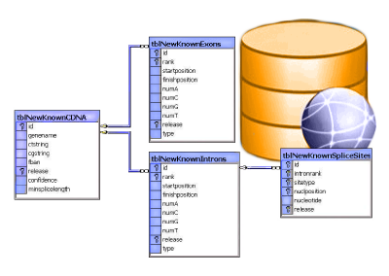
Table Relationships

Slide 25
Why Split Related Data?
Empty records
first | last | registered | email
David | Rivers | 05/02/2016 | drivers@mail.cx
Sarah | Thorne | 07/17/2016 | sarah@mail.cx
Michael | Walters | 11/23/2015 | walters_michael@mail.cx
email2
NULL
NULL
walters_michael@abv.bg
Redundant information
order_id | date | customer | product | s/n | price
00315 | 07/16/2016 | David Rivers | Oil Pump | OP147-0623 | 69.90
00315 | 07/16/2016 | David Rivers | Accessory Belt | AB544-1648 | 149.99
00316 | 07/17/2016 | Sarah Thorne | Wiper Fluid | WF000-0001 | 99.90
00317 | 07/18/2016 | Michael Walters | Oil Pump | OP147-0623 | 69.90

Slide 26
Related Tables
We split the data and introduce relationships between the tables to avoid repeating information
Connection via Foreign Key in one table pointing to the Primary Key in another
user_id | first | last | registered
203 | David | Rivers | 05/02/2016
204 | Sarah | Thorne | 07/17/2016
205 | Michael | Walters | 11/23/2015
user_id | email
203 | drivers@mail.cx
204 | sarah@mail.cx
205 | walters_michael@mail.cx
203 | david@homedomain.cx
Primary Key
Foreign Key

Slide 27
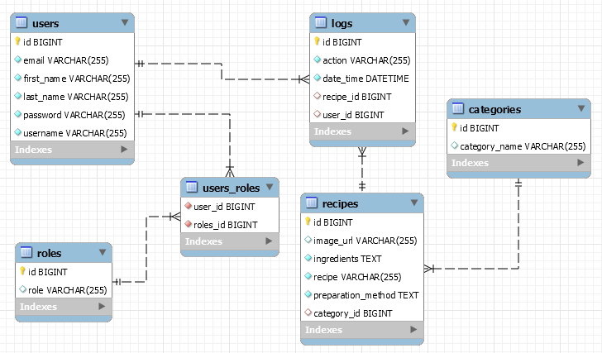
E/R Diagrams

Slide 28

Programmability

Slide 29
Indices
Indices make data lookup faster
Clustered – bound to the primary key, physically sorts data
Non-Clustered – can be any field, references the primary index
Structured as an ordered tree
PK
Index
0-99
100-199
200-299
Range 1
Range 2
Range 3
Data
Links
☰
☰
☰
☰
☰
☰
☰
☰
☰
☰
☰
☰
☰
☰

Slide 30
Views
Views are prepared queries for displaying sections of our data
Evaluated at run time – they do not increase performance
CREATE VIEW v_employee_names AS
SELECT employee_id,
first_name,
last_name
FROM employees
SELECT * FROM v_employee_names
Notes:
Views are objects that show portion of the data. For example, we may show only 3 column even though the table has 9.

Slide 31
Procedures, Functions and Triggers
A database can further be customized with reusable code
Procedures – carry out a predetermined action
E.g. get all employees with salary above 35000
Functions – receive parameters and return a result
E.g. get the age of a person using their birthdate and current date
Triggers – watch for activity in the database and react to it
E.g. when a record is deleted, write it to an archive

Slide 32
Data Types in MySQL Server

Slide 33
Numeric Data Types
Numeric data types have certain range
Their range can be changed if they are:
Signed - represent numbers both in the positive and negative ranges
Unsigned - represent numbers only in the positive range
E.g. signed and unsigned INT:
Signed Range |  | Unsigned Range
Min Value | Max Value | Min Value | Max Value
-2147483648 | 2147483648 | 0 | 4294967295

Slide 34
Numeric Data Types
INT [(M)] [UNSIGNED]
TINYINT, SMALLINT, MEDIUMINT, BIGINT
DOUBLE [(M, D)] [UNSIGNED]
E.g. DOUBLE[5, 2] – 999.99
DECIMAL [(M, D)] [UNSIGNED] [ZEROFILL]
Digits stored for value
Decimals after floating point

Slide 35
String Types (1)
String column definitions include attributes that specify the character set or collation
CHARACTER SET (Encoding)
E.g. utf8, ucs2
CHARACTER COLLATION – rules for encoding comparison
E.g. latin1_general_cs, Traditional_Spanish_ci_ai etc.
Set and collation can be defined at the database, table or column level
Determines the storage of each character (single or multiple bytes)
Determines the sorting order and case-sensitivity

Slide 36
CHARACTER COLLATION – Example
ORDER BY with different collations
latin1_swedish_ci | latin1_german1_ci | latin1_german2_ci
Muffler | Muffler | Müller
MX Systems | Müller | Muffler
Müller | MX Systems | MX Systems
MySQL | MySQL | MySQL

Slide 37
String Types (2)
CHAR [(M)] - up to 255 characters
fixed-length character type (example CHAR(30))
VARCHAR(M) - up to 65 535. The effective maximum length is a subject to the maximum row size (65,535 bytes, which is shared among all columns) and the character set used
Variable max size
TEXT - up to 65 535 characters
TINYTEXT, MEDIUMTEXT, LONGTEXT
BLOB - Binary Large Object [(M)] - 65 535 (2¹⁶ - 1) characters
TINYBLOB, MEDIUMBLOB, LONGBLOB

Slide 38
CHAR vs VARCHAR
Storing data in CHAR and VARCHAR examples
Value | CHAR(4) | Storage Required | VARCHAR(4) | Storage Required
'' | ' ' | 4 bytes | '' | 1 bytes
'ab' | 'ab ' | 4 bytes | 'ab' | 3 bytes
'abcd' | 'abcd' | 4 bytes | 'abcd' | 5 bytes
'abcdefgh' | 'abcd' | 4 bytes | 'abcd' | 5 bytes

Slide 39
Date Types (1)
DATE - for values with a date part but no time part
TIME - for values with time but no date part
DATETIME - values that contain both date and time parts
TIMESTAMP - both date and time parts
DATETIME and TIMESTAMP have different time ranges
Column name | Column Type
birthdate | DATE
last_time_online | TIMESTAMP
start_at | TIME
deleted_on | DATETIME

Slide 40
Date Types (2)
MySQL retrieves values for a given date type in a standard output format
E.g. as a string in either 'YYYY-MM-DD' or 'YY-MM-DD'
Data Type | Column Type
DATE | '0000-00-00'
TIME | '00:00:00'
DATETIME | '0000-00-00 00:00:00'
TIMESTAMP | '0000-00-00 00:00:00'
YEAR | 0000

Slide 41


Database Modeling

Slide 42

Working with IDEs
We will manage databases with MySQL Workbench
Enables us:
To create a new database
To create objects in the database (tables, stored procedures, relationships and others)
To change the properties of objects
To enter records into the tables

Slide 43
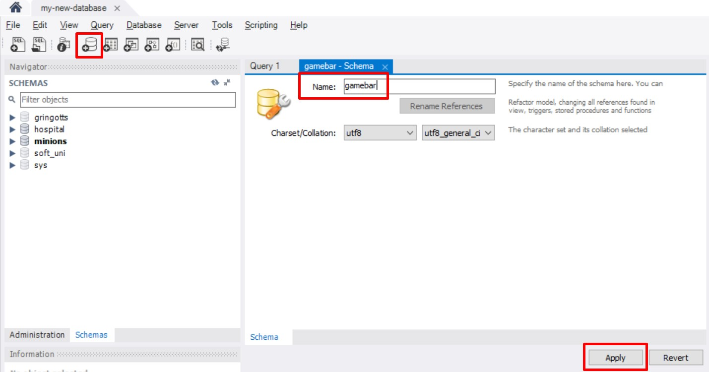
Creating a New Database
Select Create new schema from the command menu

Slide 44
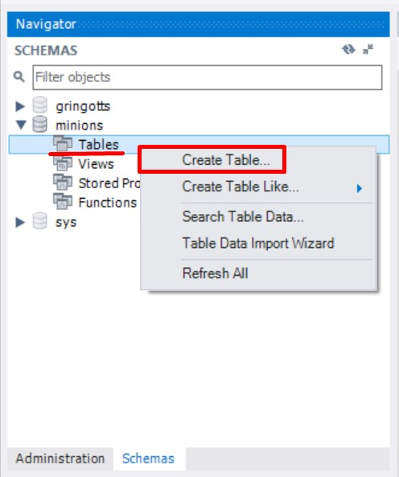
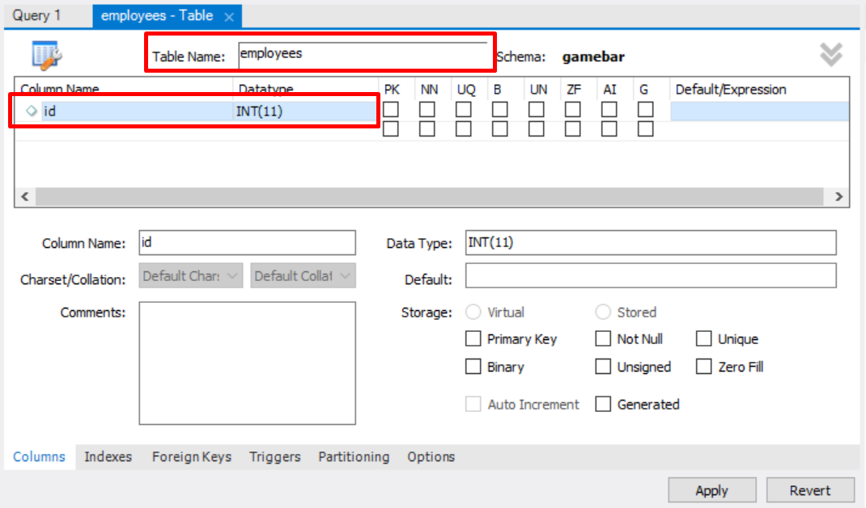
Creating Tables
Right click on "Tables" Select Create Table
Set up table name
Add new record
Create new table

Slide 45
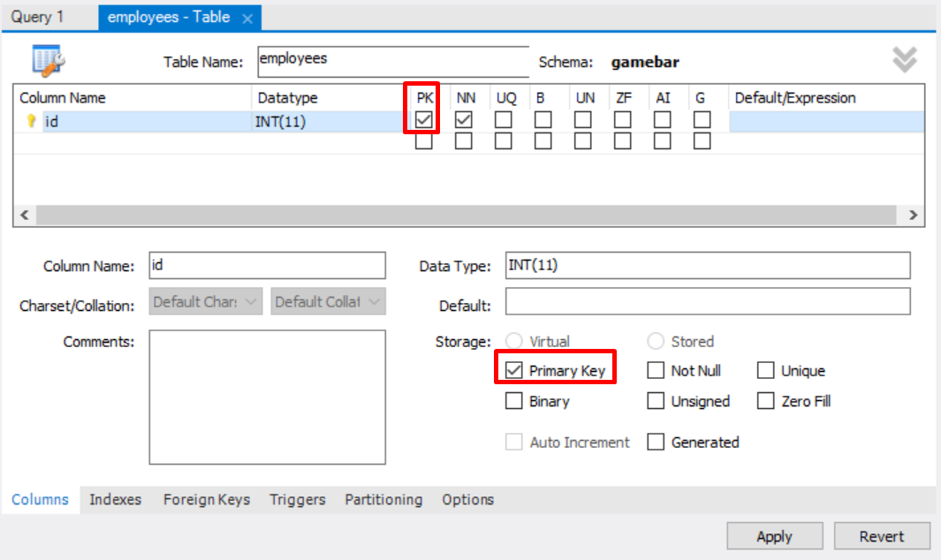
Creating Tables (2)
A Primary Key is used to uniquely identify and index records

Slide 46
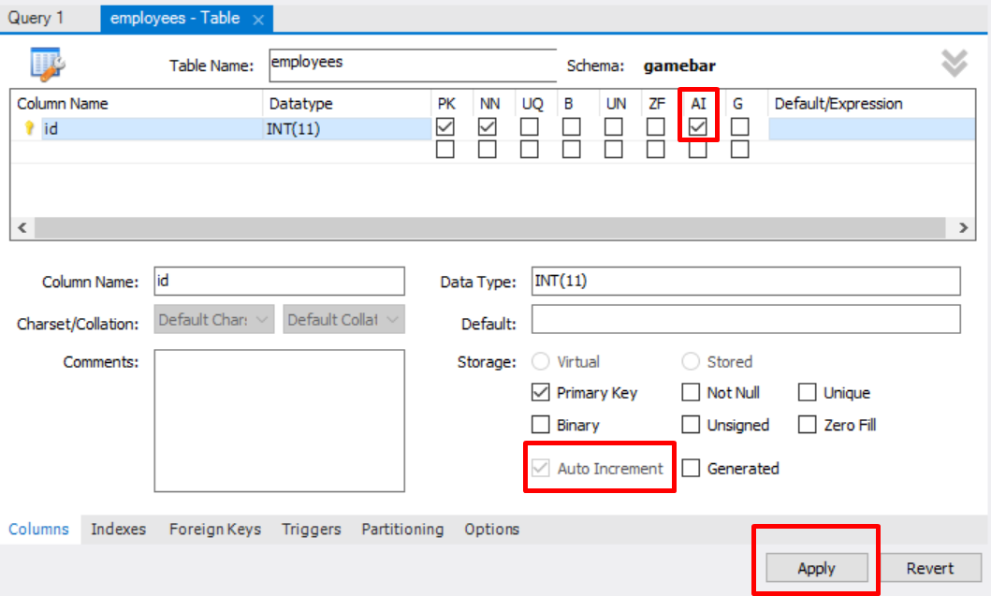
Creating Tables (3)
Auto increment – on the "Default" field

Slide 47
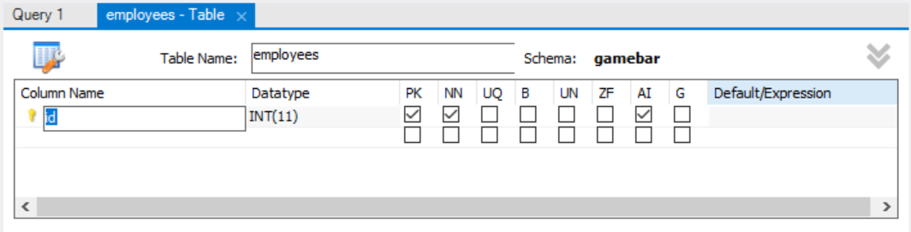
Storing and Retrieving Data
We can add, modify and read records with GUI Clients
To insert or edit a record, click inside the cell

Slide 48
Basic SQL Queries
CREATE TABLE people
(
id INT NOT NULL,
email VARCHAR(50) NOT NULL,
first_name VARCHAR(50),
last_name VARCHAR(50)
);

Slide 49
SQL Queries
We communicate with the database engine using SQL
Queries provide greater control and flexibility
To create a database using SQL:
SQL keywords are conventionally capitalized
Database name
CREATE DATABASE employees;

Slide 50
Table Creation in SQL
Table name
CREATE TABLE people
(
id INT NOT NULL,
email VARCHAR(50) NOT NULL,
first_name VARCHAR(50),
last_name VARCHAR(50)
);
Custom properties
Data type
Column name

Slide 51
Retrieve Records in SQL
Get all information from a table
You can limit the columns and number of records
Table name
SELECT * FROM employees;
SELECT first_name, last_name FROM employees LIMIT 5;
List of columns
Number of records

Slide 52

Table Customization

Slide 53
Custom Column Properties
Primary Key
Auto-Increment (Identity)
Unique constraint – no repeating values in entire table
Default value – if not specified (otherwise set to NULL)
id INT NOT NULL PRIMARY KEY
id INT AUTO_INCREMENT PRIMARY KEY
email VARCHAR(50) UNIQUE
balance DECIMAL(10,2) DEFAULT 0

Slide 54
Problems: Create and Insert
Create new Database "gamebar"
Create Tables:
employees - id, first_name, last_name
categories - id, name
products - id, name, category_id
Insert Data:
Populate the employees table with 3 test values

Slide 55
Altering Tables

Slide 56
Altering Tables Using SQL (1)
A table can be changed using the keywords ALTER TABLE
Add new column
ALTER TABLE employees;
Table name
ALTER TABLE employees
ADD COLUMN salary DECIMAL;
Column name
Data type

Slide 57
Altering Tables Using SQL (2)
Delete existing column
Modify data type of existing column
ALTER TABLE people
DROP COLUMN full_name;
Column name
ALTER TABLE people MODIFY COLUMN email VARCHAR(100);
Column name
New data type

Slide 58
Altering Tables Using SQL (3)
Add primary key to existing column
Add unique constraint
ALTER TABLE people ADD CONSTRAINT pk_id
PRIMARY KEY (id);
Constraint name
Column name
(more than one for composite key)
Constraint name
ALTER TABLE people ADD CONSTRAINT uq_email
UNIQUE (email)
Columns name(s)

Slide 59
Altering Tables Using SQL (4)
Set default value
ALTER TABLE people ALTER COLUMN balance SET DEFAULT 0;
Default value
Column name

Slide 60
Problems: Alter Tables
Alter table
Add a new column – "middle_name" to the "employees" table
Adding Constraints
Make "category_id" foreign key linked to "id" in the "categories" table
Modifying Columns
Change the property "VARCHAR(50)" to "VARCHAR(100)" to the "middle_name" column in "employees" table

Slide 61

Deleting Data and Structures

Slide 62
Deleting from Database
Deleting structures is called dropping
You can drop keys, constraints, tables and entire databases
Deleting all data in a table is called truncating
Both of these actions cannot be undone – use with caution!

Slide 63
Dropping and Truncating
To delete all the entries in a table
To drop a table – delete data and structure
To drop entire database
TRUNCATE TABLE employees;
Table name
DROP TABLE employees;
Table name
DROP DATABASE soft_uni;
Database name

Slide 64
Dropping and Truncating (2)
To remove a constraining rule from a column
Primary keys, value constraints and unique fields
To remove DEFAULT value (if not specified, revert to NULL)
Table name
ALTER TABLE employess DROP CONSTRAINT pk_id;
Constraint name
Table name
ALTER TABLE employess ALTER COLUMN clients
DROP DEFAULT;
Columns name

Slide 65

Summary
…
…
…
We communicate with the DB engine via SQL
MySQL is a multiplatform RDBMS using SQL
Table columns have a fixed type
We can use GUI Clients to create and customize tables
SQL provides greater control

Slide 66
Questions?
Notes:
66

Slide 67











SoftUni Diamond Partners

Slide 68


Educational Partners

Slide 69
Trainings @ Software University (SoftUni)
Software University – High-Quality Education, Profession and Job for Software Developers
softuni.bg, about.softuni.bg
Software University Foundation
softuni.foundation
Software University @ Facebook
facebook.com/SoftwareUniversity
Software University Forums
forum.softuni.bg
Notes:
69

Slide 70

License
This course (slides, examples, demos, exercises, homework, documents, videos and other assets) is copyrighted content
Unauthorized copy, reproduction or use is illegal
© SoftUni – https://about.softuni.bg/
© Software University – https://softuni.bg
Notes:
70

